Slide 1
Go AMS Meetup June ‘23
Lightning talk
slog
Arno Overgaauw
github @ArnoSen
me@km42.nl

Slide 2
Who am I?
Working in IT for around 25 years.
Golang developer for 5 years
Working for Accenture (after acquisition of Sentia a managed service provider, in 2022)
Hobbies: sailing + running (focus on marathons)

Slide 3
At the end of the session, you (hopefully)
Have an overview what slog can do
Have an idea about the key objects in slog
Got an awareness how to make slog do what you want it to do
Are aware of recommendations

Slide 4
Why slog?
Limited functionality and configuration options of the log package
Lots of people use structured logging through third party libraries. The goal is to unify logging across Go with slog
Structured logging exists to make it easer for machines to read logs

Slide 5
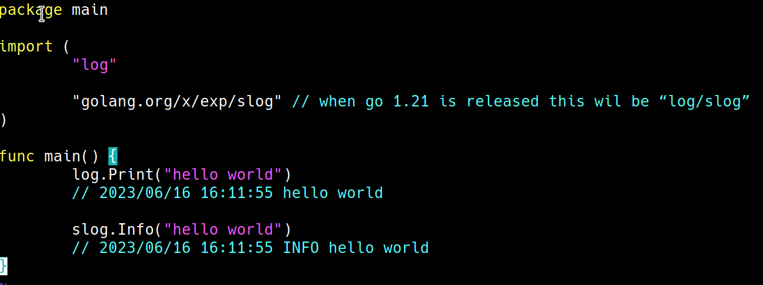
What can slog do for you?

Slide 6
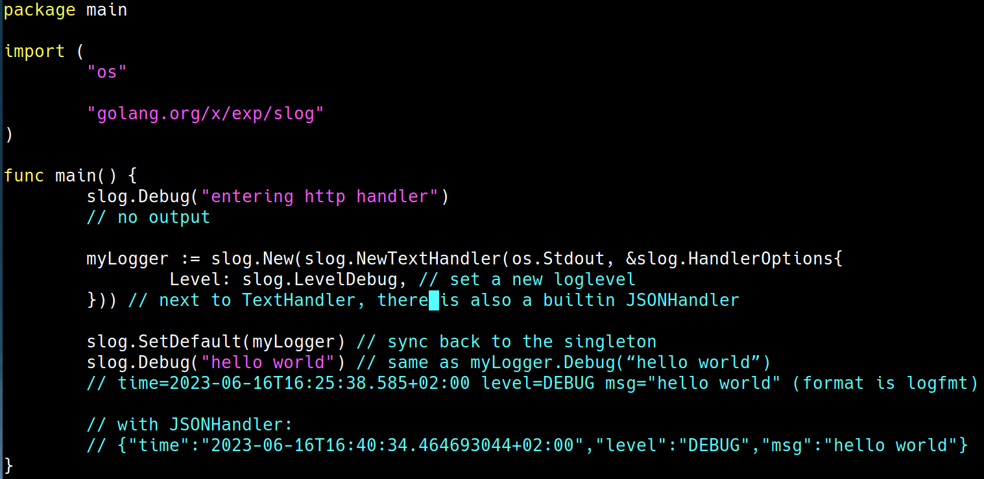
Handlers and log levels

Slide 7
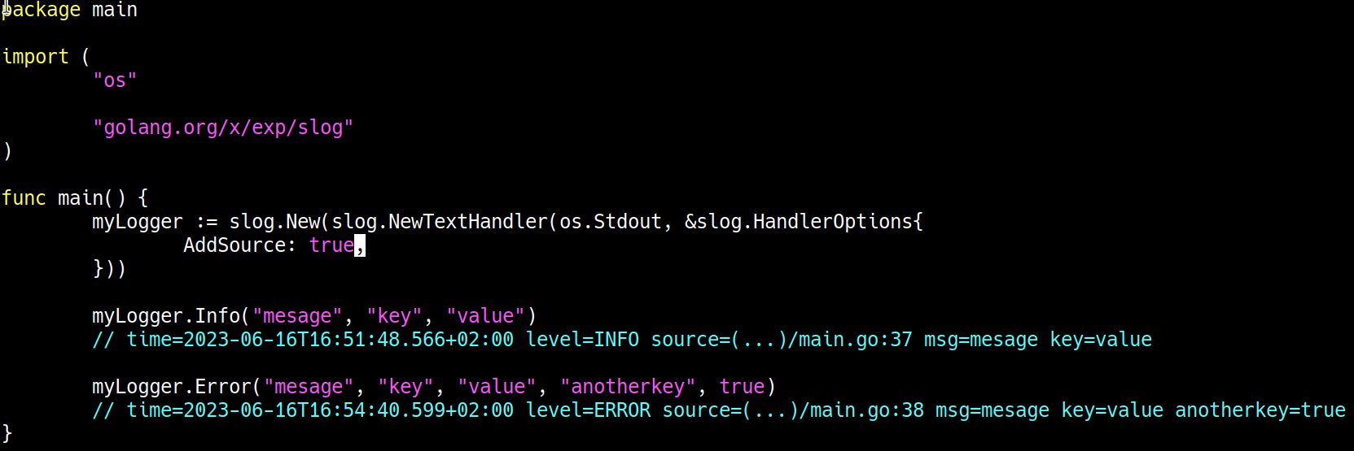
Values

Slide 8
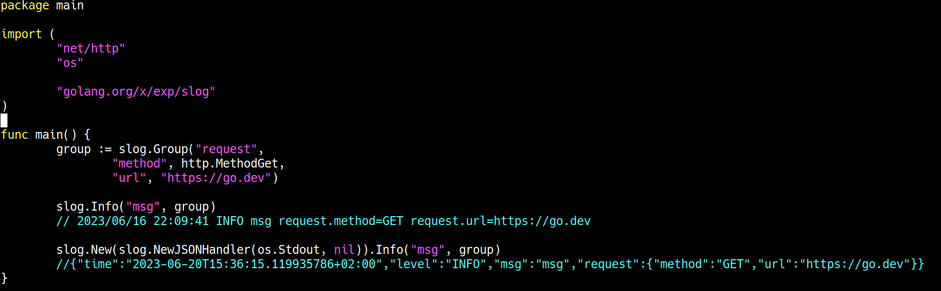
Groups

Slide 9
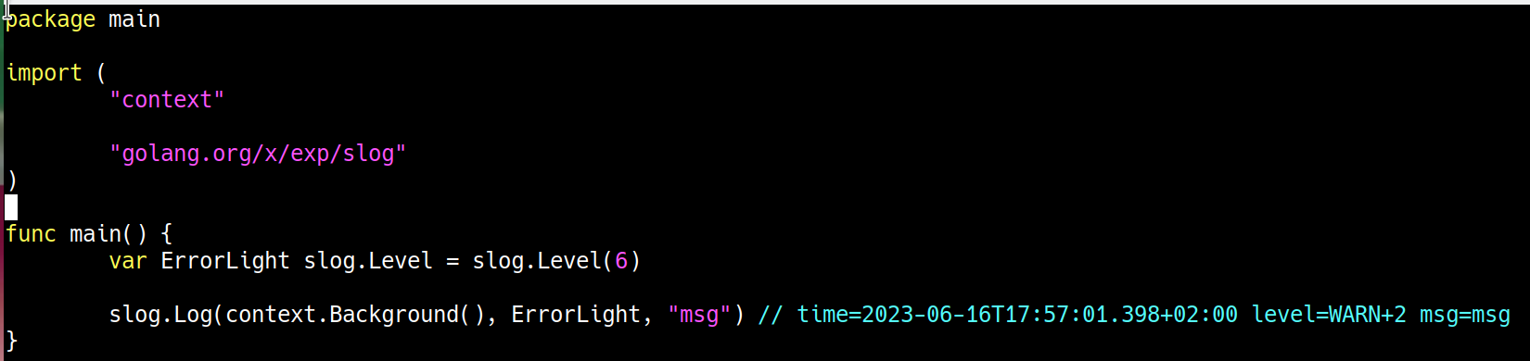
Levels
4 built in levels: debug, warn, info, error
Level is an int. debug=-4, error=8
You can define your own levels

Slide 10
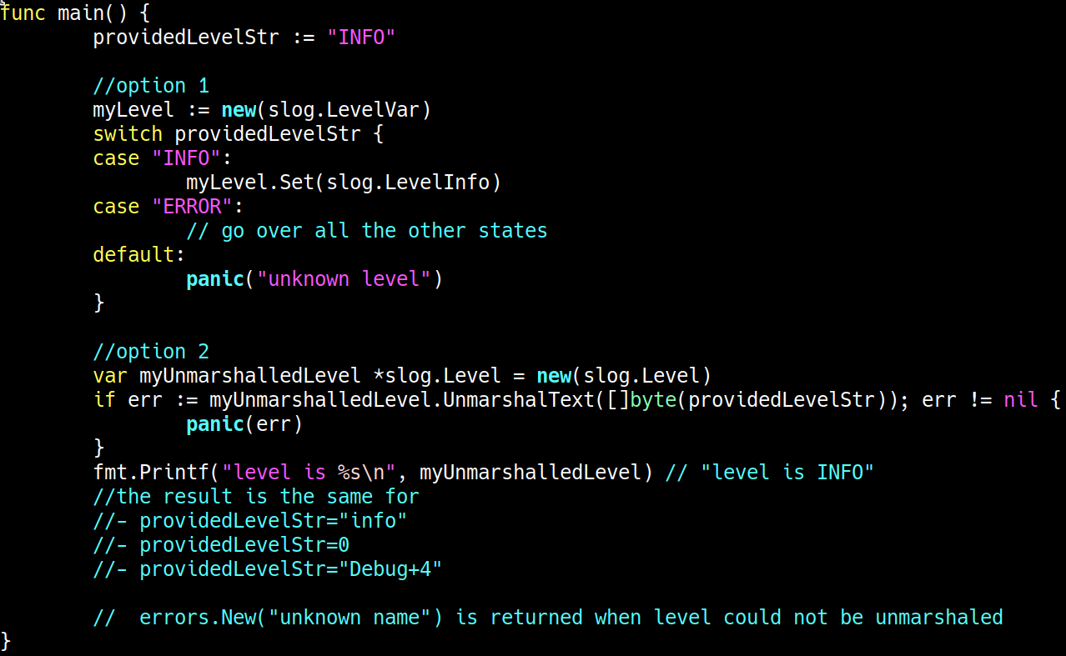
Log level parsing

Slide 11
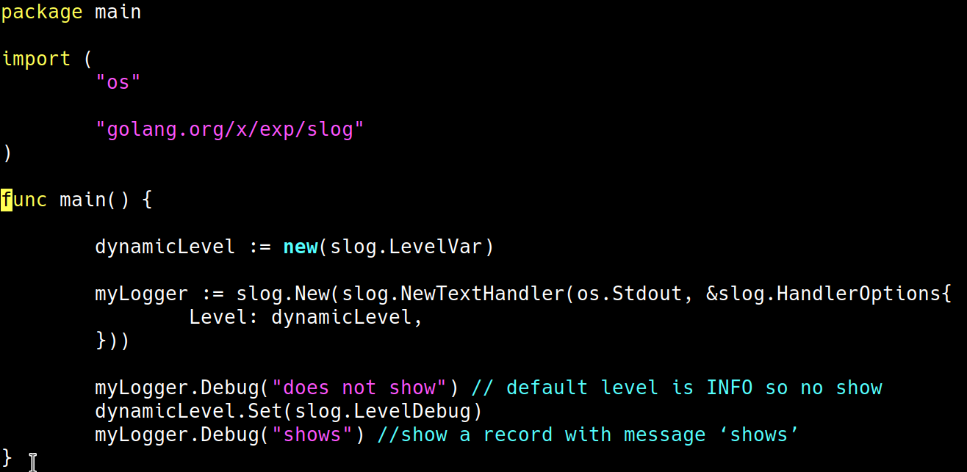
Change loglevel after logger instantion

Slide 12
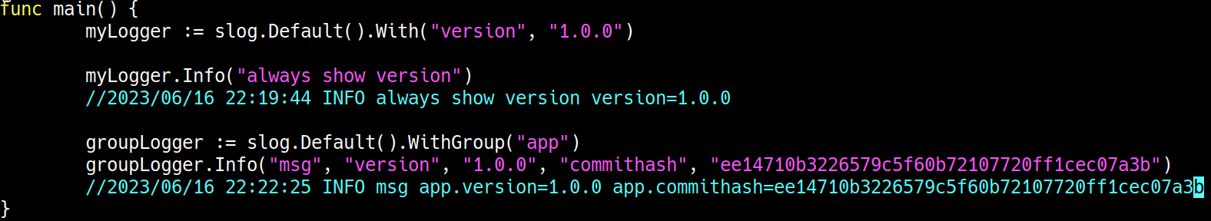
Add values to loggers (‘stateful’ loggers)

Slide 13
Customizations
LogLevels
Handlers: handlers determine how a message is logged. See https://github.com/golang/go/wiki/Resources-for-slog for a list of 3d party availabe handlers (e.g. colored output)
Values (e.g. slog.Error(“msg”, “key”, value <any>) ): implement slog.LogValuer to serialize your object. NB: supported ‘output’ types are: string, bool, (non-complex) numeric types (Uint64, Int64, or Float64), time or duration
Default field names are 'time', 'level', 'source' and 'msg'. To override these, set a custom HandlerOptions.ReplaceAttr function

Slide 14
Recommendations
When a context is available, use: DebugCtx, InfoCtx, WarnCtx, ErrorCtx. Implement a custom Handler (method Handle(context.Context, Record) error ) to parse information from the context
Performance: when a loglevel is not reached, it’s values are computed.

Slide 15
Changes to the proposal in the past
You may find articles talking about a NewContext method “ctx := slog.NewContext(context.Background(), logger)”. After debate this was removed from the proposal.

Slide 16
Conclusion
Looks like a complete library
Lots of customization options that should make it possible to do the same thing with slog as through third party libraries
Maybe the loglevel should have been an interface so you can have custom level names instead of names like Debug+2

Slide 17
Questions?

